Slide 1
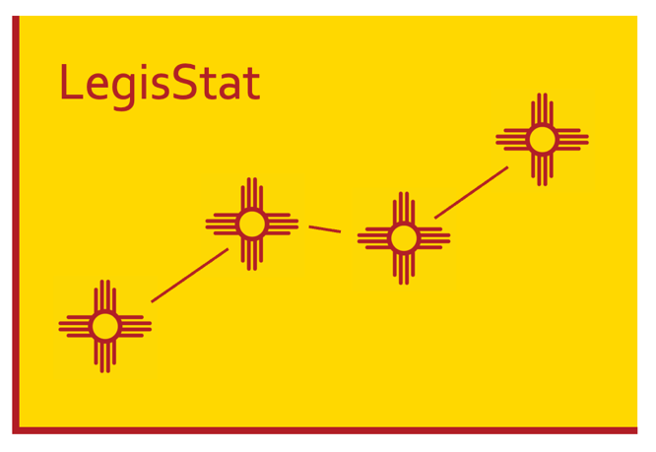
Overview Presentation | June 2022

Slide 2
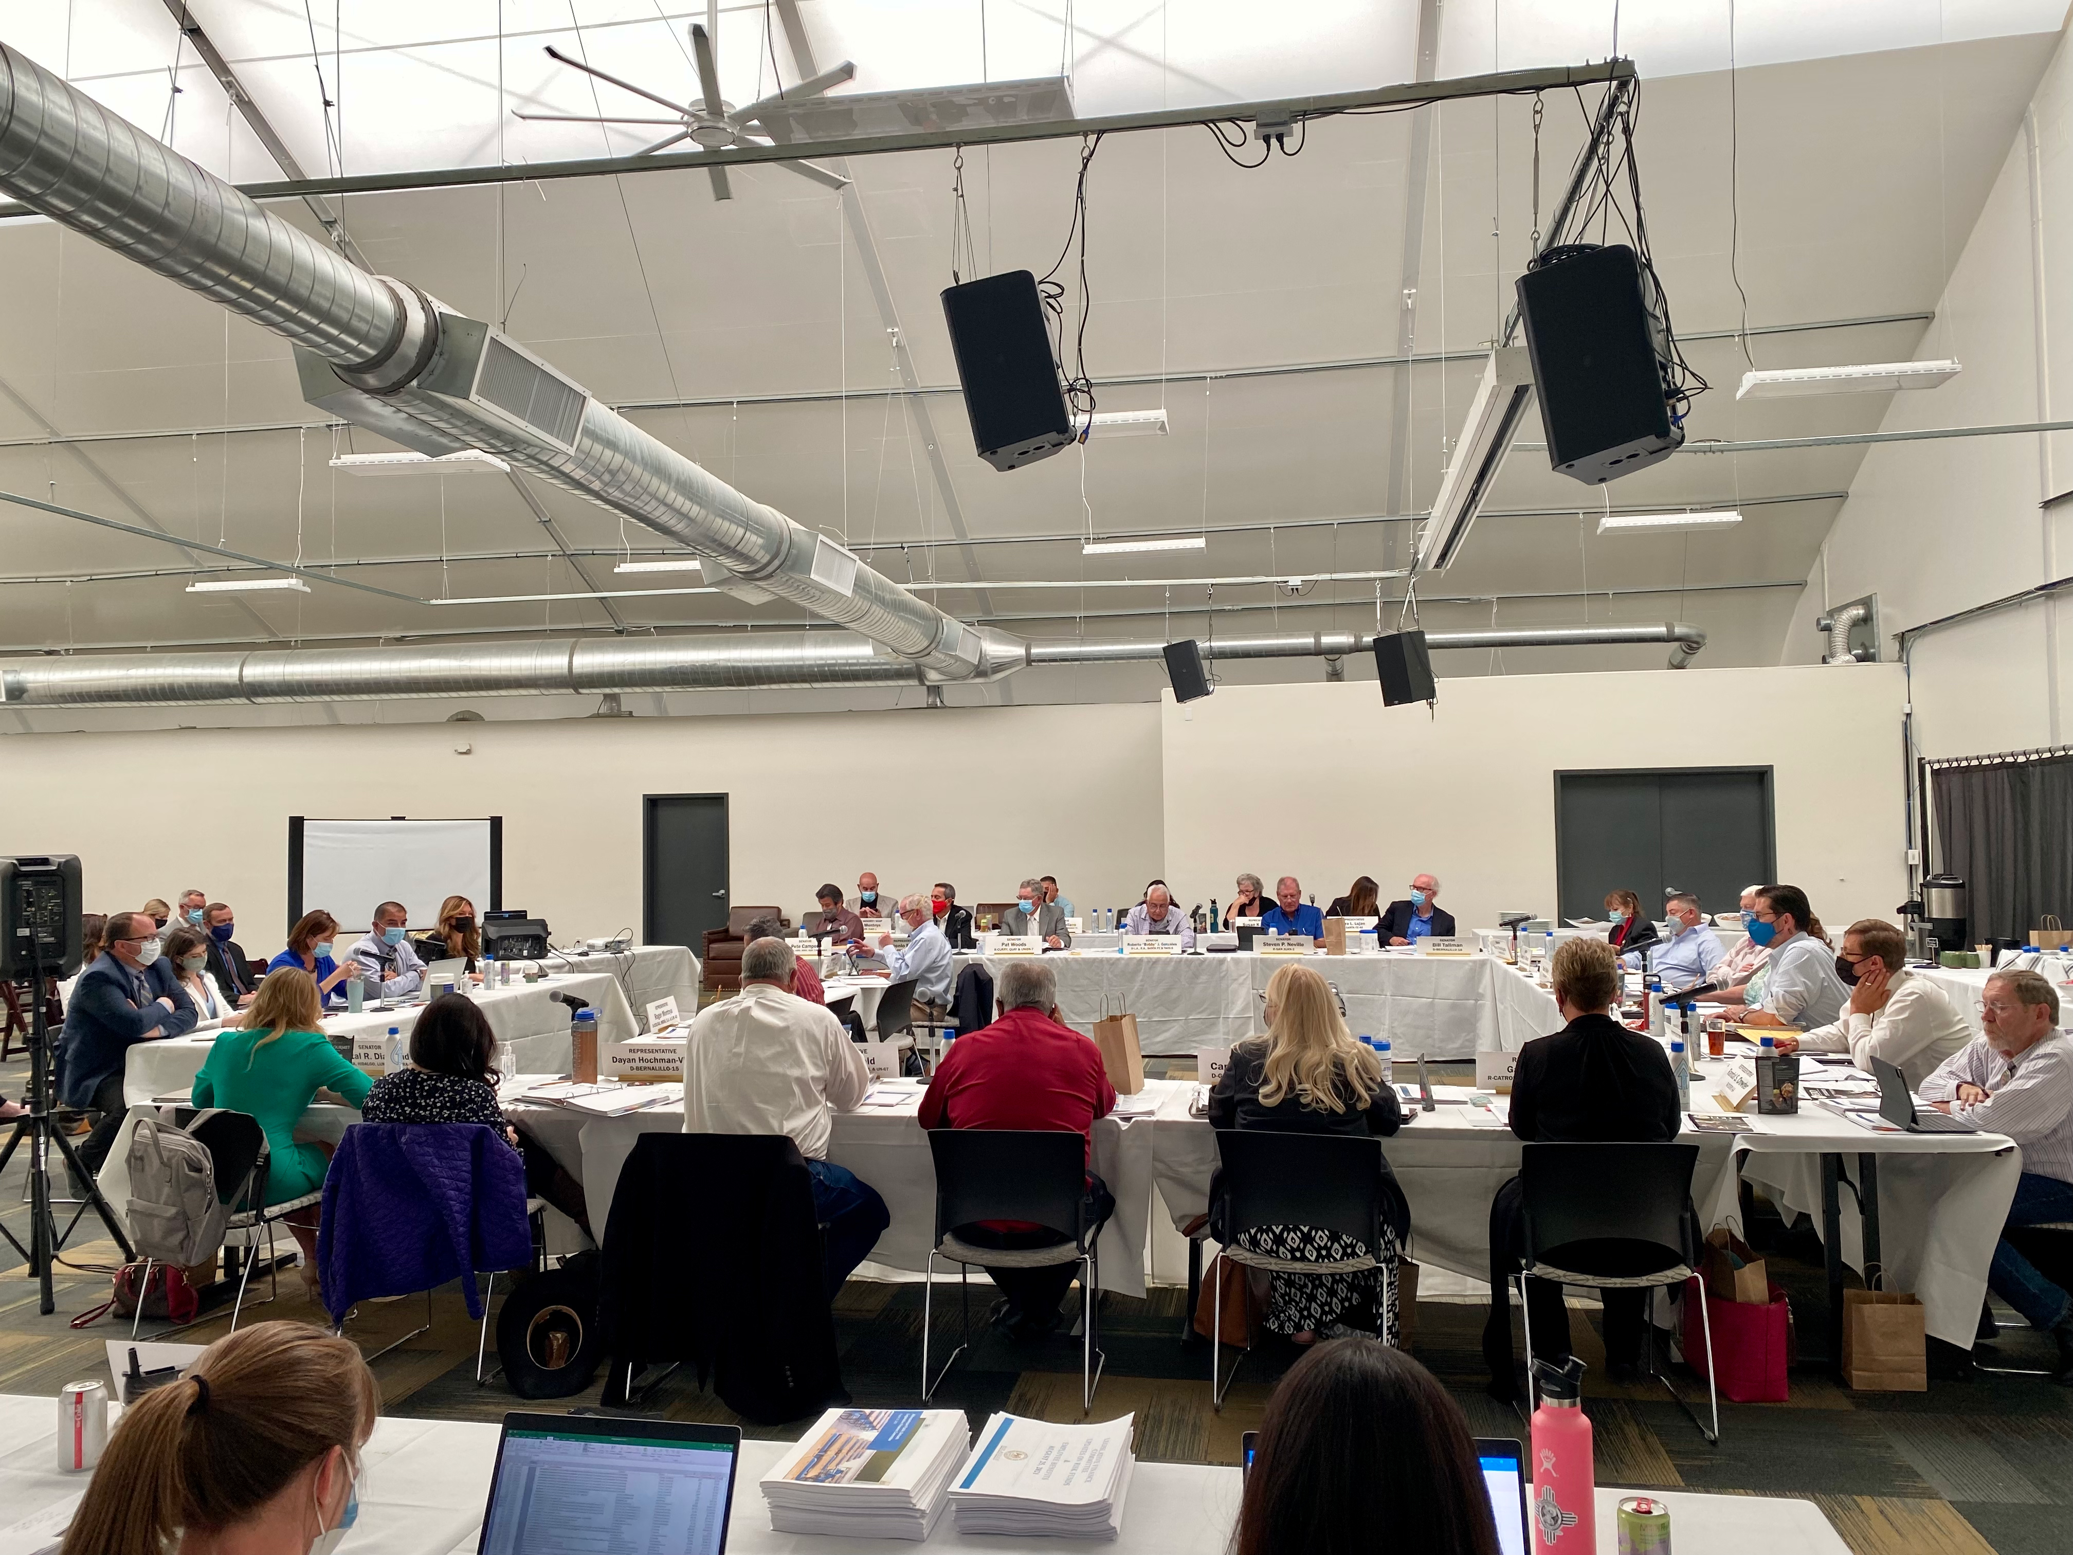
Introduction
In August 2021, LFC launched LegisStat, first adaptation of PerformanceStat strategy to a legislative context.
Builds on existing efforts in New Mexico around evidence-based budgeting.
Broad goal: Strengthen collaboration with state agencies in monitoring the implementation of state programs and improve state budget decisions.

Slide 3
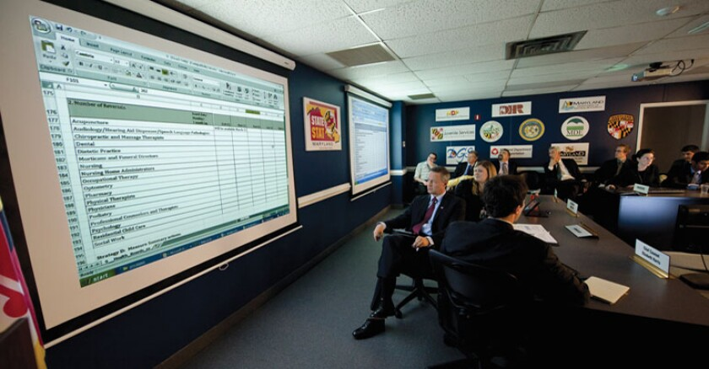
The PerformanceStat Movement
PerformanceStat involves ongoing, regular meetings between executive leadership and departments or bureaus.
Participants review key performance measures and diagnose performance deficits, then decide how to fix those problems.
Examples include CitiStat in Baltimore, StateStat in Maryland (picture at right) and many others.

Slide 4
Motivations for Launching LegisStat
Changing the format of agency hearings.
Strengthening a focus on key agency performance challenges that are mission oriented.
Better tracking priority policies and programs.
Making discussions more data-driven.
Sustaining a focus on key challenges over time.

Slide 5
LegisStat Meetings to Date
Meetings so far with:
Department of Workforce Solutions
Higher Education Department
Public Education Department
Economic Development Department
Tourism Department

Slide 6
Principles of LegisStat
Focused: Meetings focus on most important challenges facing agencies, identified ahead of time.
Committee-driven: Meetings driven by the committee chair and by members’ questions; only short presentations.
Emphasizing deeper dives: Use of follow-up questions by members to get to the root causes of problems…“the Five Whys.”
Action-oriented: Agencies ideally commit to specific actions by the next meeting, representing near-term actions even if long-term challenges.
Strong on accountability: Meetings designed to start with agency updates on action items from previous meeting.
Collaborative: Meetings require ongoing collaboration between legislators and agency leaders.
Aiming for impact: Important part of the initiative’s impact occurs between meetings, when agencies work to achieve action items committed to during the meetings.

Slide 7
LegisStat Process
Preparation for meetings
  Prep by LFC Staff including briefing memo
  Prep meeting with Chair(s) prior to meeting
Meeting
  Updates from LFC analyst, including on action items by agency
  Brief presentation (5 min) from agency head
  Member questions on agency priority challenge #1 and discussion
    Identification of action items
  Same for challenge #2 and #3 (if time allows)
Between meetings
  LFC staff follow-up on action items; hear feedback from agency

Slide 8
Advancing Performance Management
Following the LegisStat Process will allow LFC to:
Emphasize a cadence of accountability,
Establish hearing standardization to grow comfortable with the format, and
Reevaluate progress each time the agency goes before the committee.
The committee will more effectively lead the executive to improved performance.

Slide 9
A Few Things to Keep in Mind
  What do we want from the agency that we are not currently getting?
  What story does currently available data tell and what story could better data tell us?
  What is the goal of the hearing and how will this hearing advance the selected performance issues?
  Does the agency have an action plan to address the performance issue? If not can we get a commitment to develop one?
  What are the main questions you want answered? If these questions were answered what would follow-up hearings look like?
  What are the next steps?

Slide 10
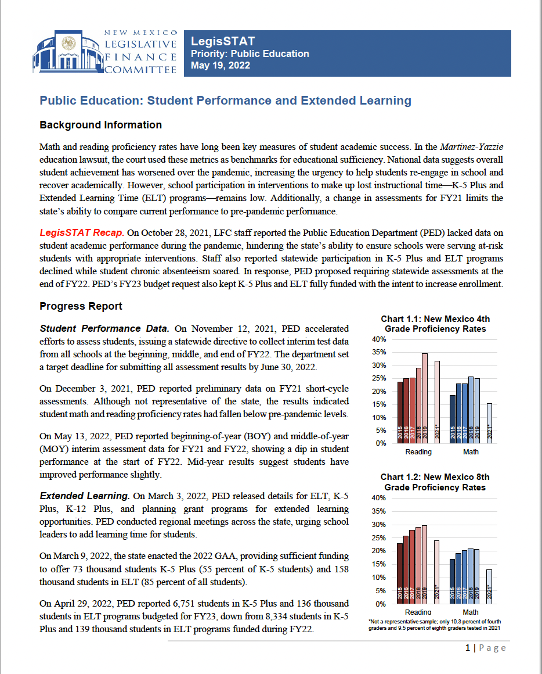
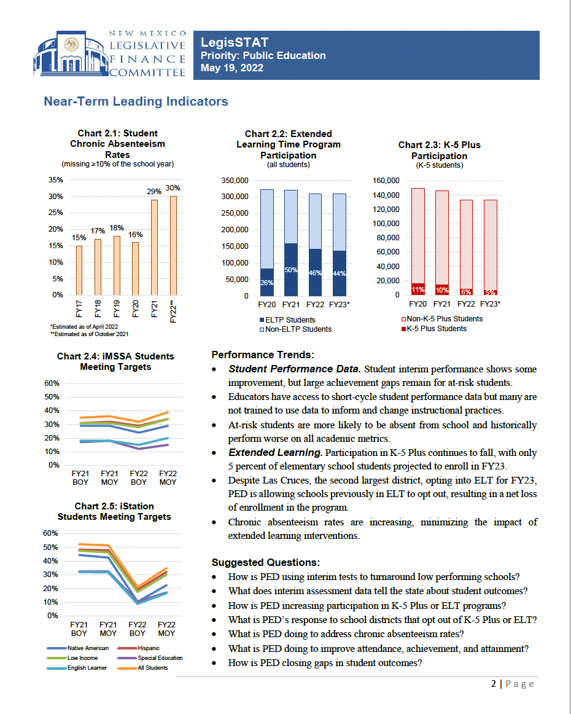
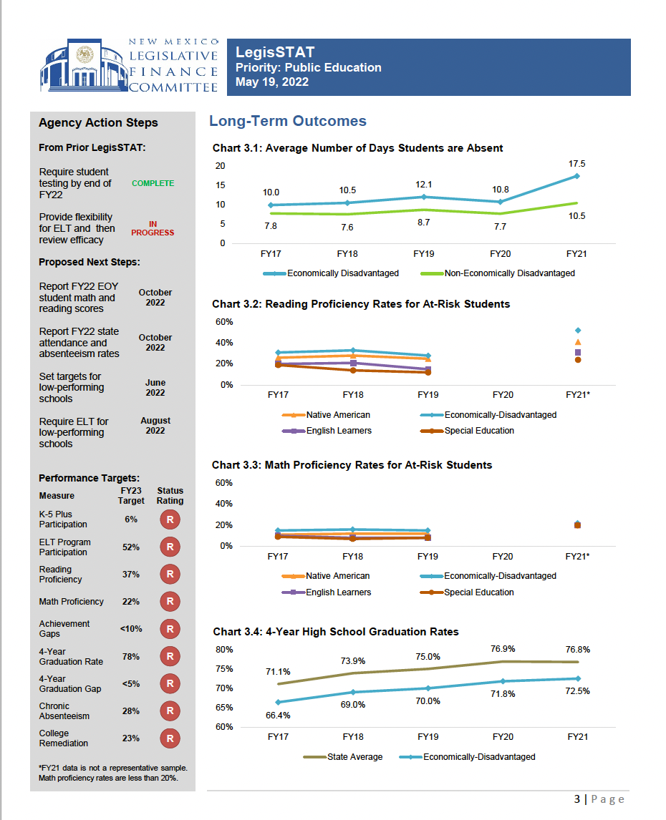
LegisStat Briefing Materials

Slide 11
Results / Observations to Date
Successes
Obvious change in dynamic of meetings
Feeling of empowerment by members
Agencies being responsive – e.g., PED action on data
Agencies realizing it’s not “gotcha”
Support of Chair and members for continuation and expansion
Challenges
Need to dig deeper into issues / get to specifics / creation of action items

Slide 12
Development and Scale-Up Going Forward
Chair Lundstrom’s direction to expand the initiative
New LegisStat subcommittee
Some meetings likely will be carveout of budget hearings; others part of special subcommittee
Scoring of results-focused government best practices (next slide)

Slide 13
Two components of LegisStat
Goal: Make progress on high-priority agency challenges as identified by the Committee.
Main component: Ongoing LegisStat meetings.
Parallel effort: Yearly rating of selected agencies’ use of best practices in evidence + performance + data.
Goal: Strengthen agencies’ capacity for high-performance government

Slide 14
Q&A

